Slide 1
Driving Indicators for Employee Retention
Jeff Watson – AHWFB-IAS

Slide 2
Turnover is Expensive
Hiring Costs
Training Costs
Lost Productivity
213% of annual salary
Estimated cost to replace skilled position

Slide 3
Key Points
Data Discussion
Data Disclaimer
Data Exclusions
Tenure
Pay Increases
Gender Discussion

Slide 4
The Data
Employment information from 3rd party client
All employees during 2020-2021
Termination status, type, and reason
Voluntary vs involuntary
Retirement, a new position, dissatisfaction, etc.

Slide 5
Disclaimer
Data is from 2020-2021
Abnormal amount of turnover nationwide
Unknown effect from lockdowns
Data may not translate outside this company

Slide 6
Some Data Exclusions
Involuntary terminations and Retirement
Data insufficient to determine retention potential
Tenure greater than 30 years
Demonstrated no bearing on retention

Slide 7

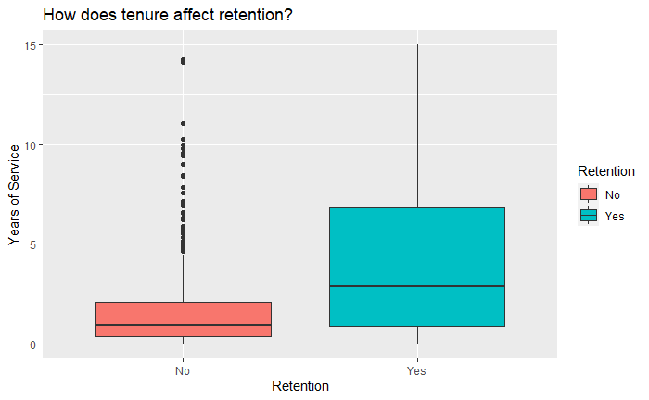
Tenure
Median Retained: 2.9 years
Median Terminated: 0.92 years

Slide 8
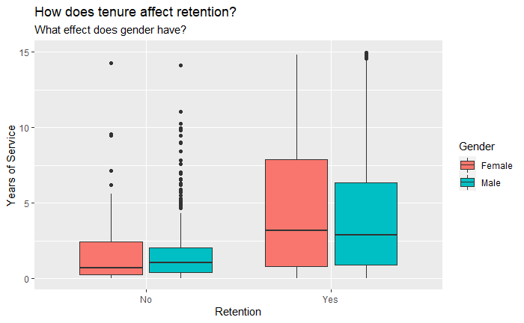
Tenure and Gender

Slide 9
Number of Pay Increases
Number of pay increases during 2020-2021
No information about prior compensation
Most correlated variable to employee turnover

Slide 10
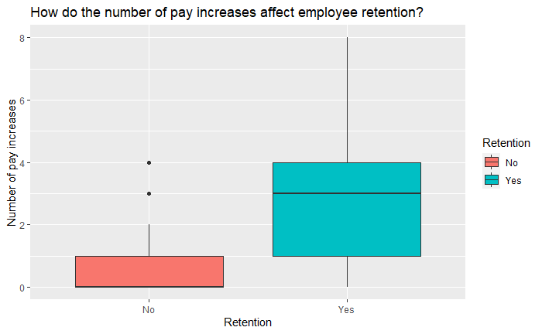
Pay Increases

Slide 11
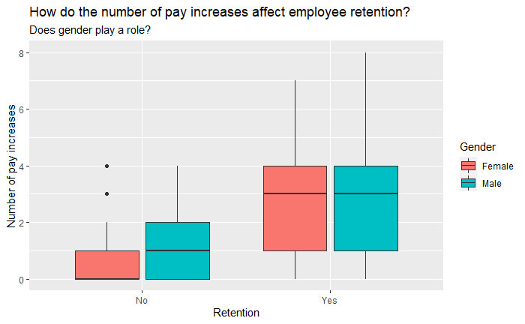
Pay Increases and Gender

Slide 12
Conclusion
Get employees to critical tenure duration
Pay increases
biggest driver of employee retention

